Slide 1
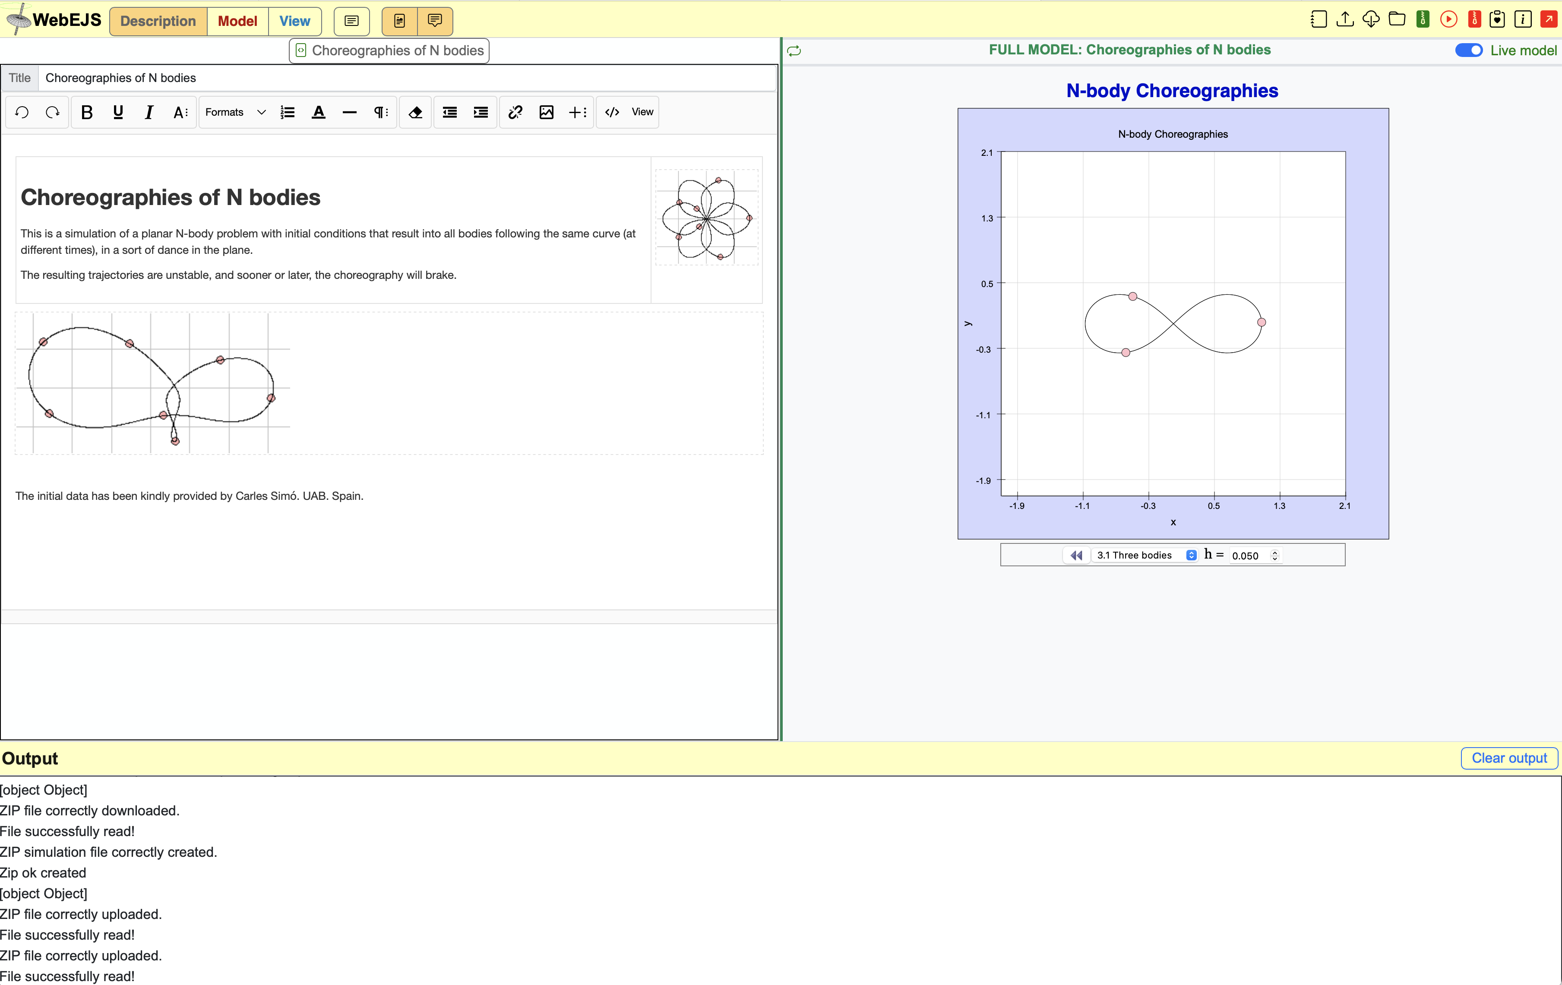
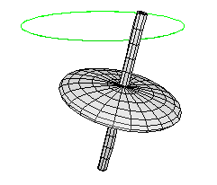
EJS Architecture
Francisco Esquembre
Creation of Interactive Resources Using the WebEJS Authoring Toolkit
Powered by WebEJS

Slide 2
A simple interface for a simple
simulation structure
INPUT
Three work panels:
Description
Model
View
Creation of Interactive Resources Using the WebEJS Authoring Toolkit
Powered by WebEJS

Slide 3
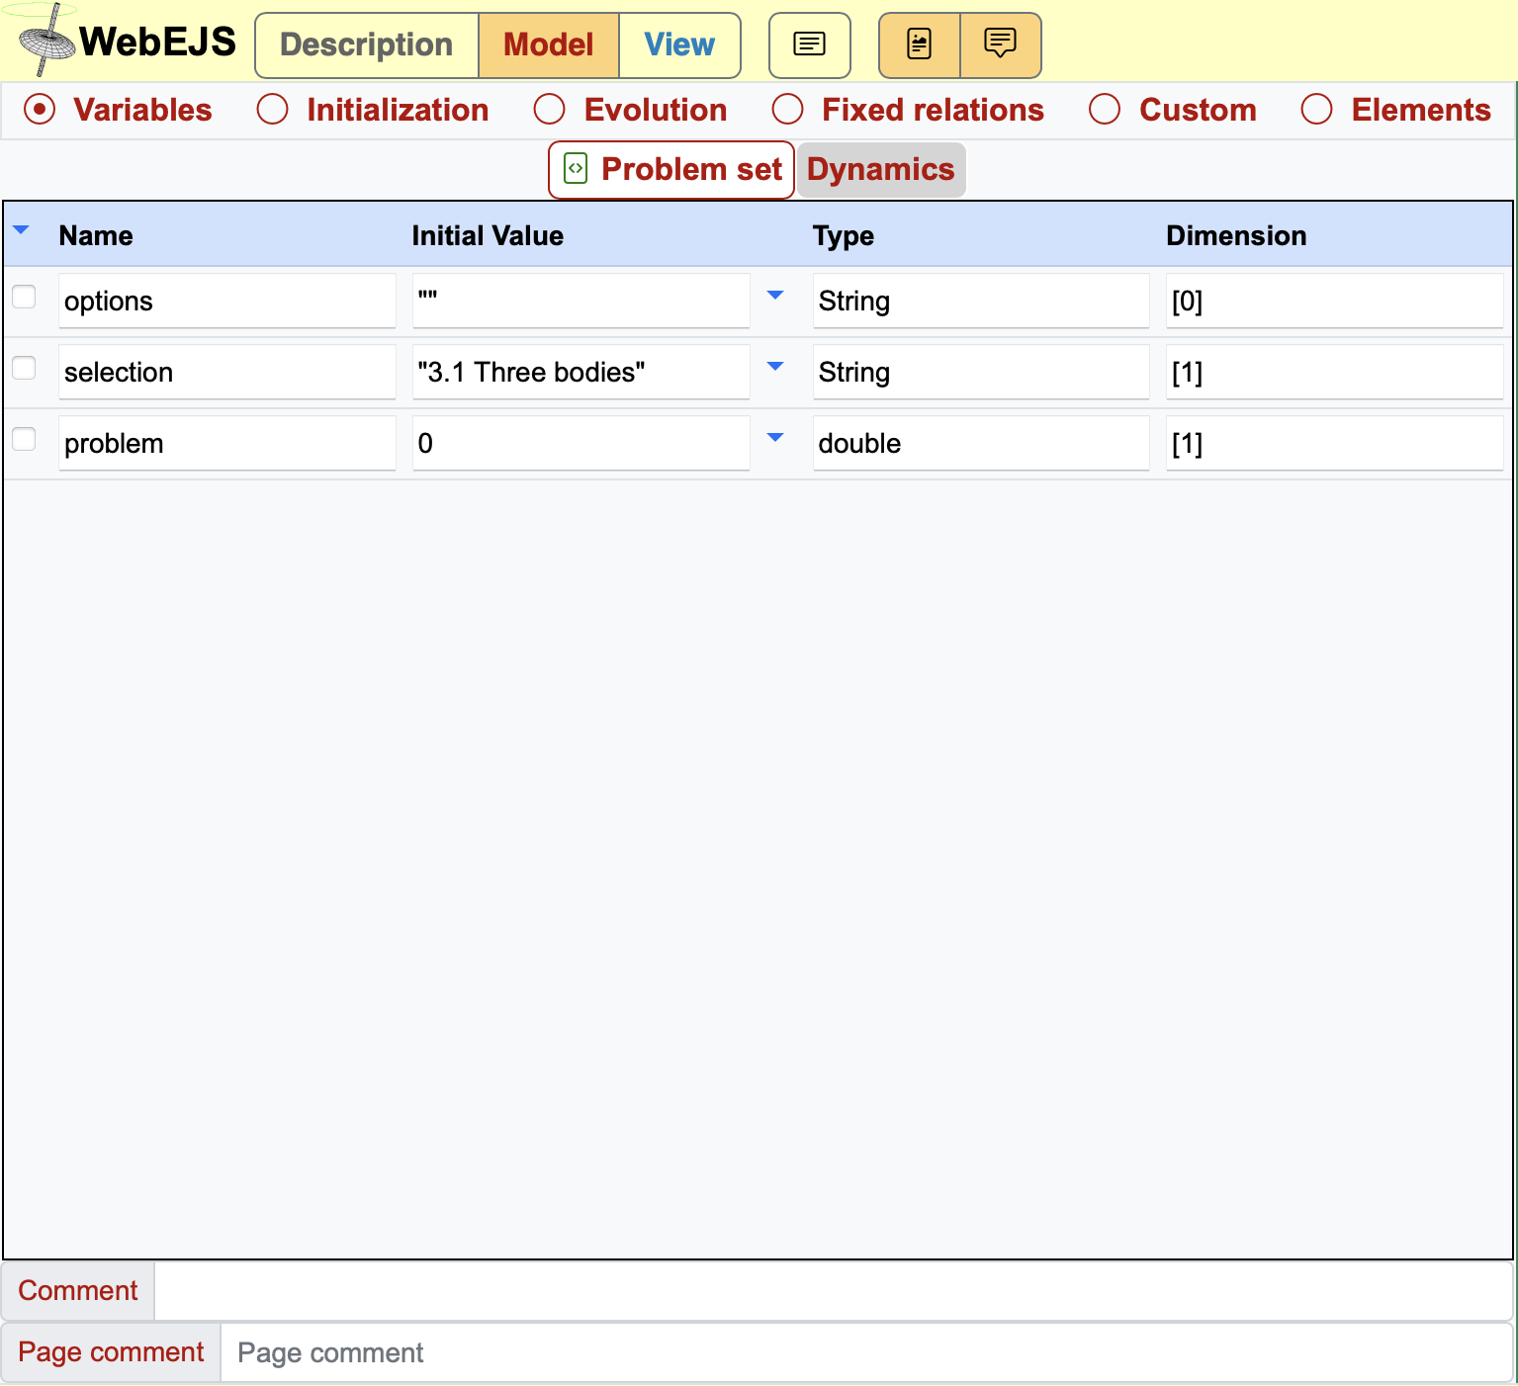
A simple interface for a simple
simulation structure
INPUT
Three work panels:
Description
Model
View
Creation of Interactive Resources Using the WebEJS Authoring Toolkit
Powered by WebEJS

Slide 4
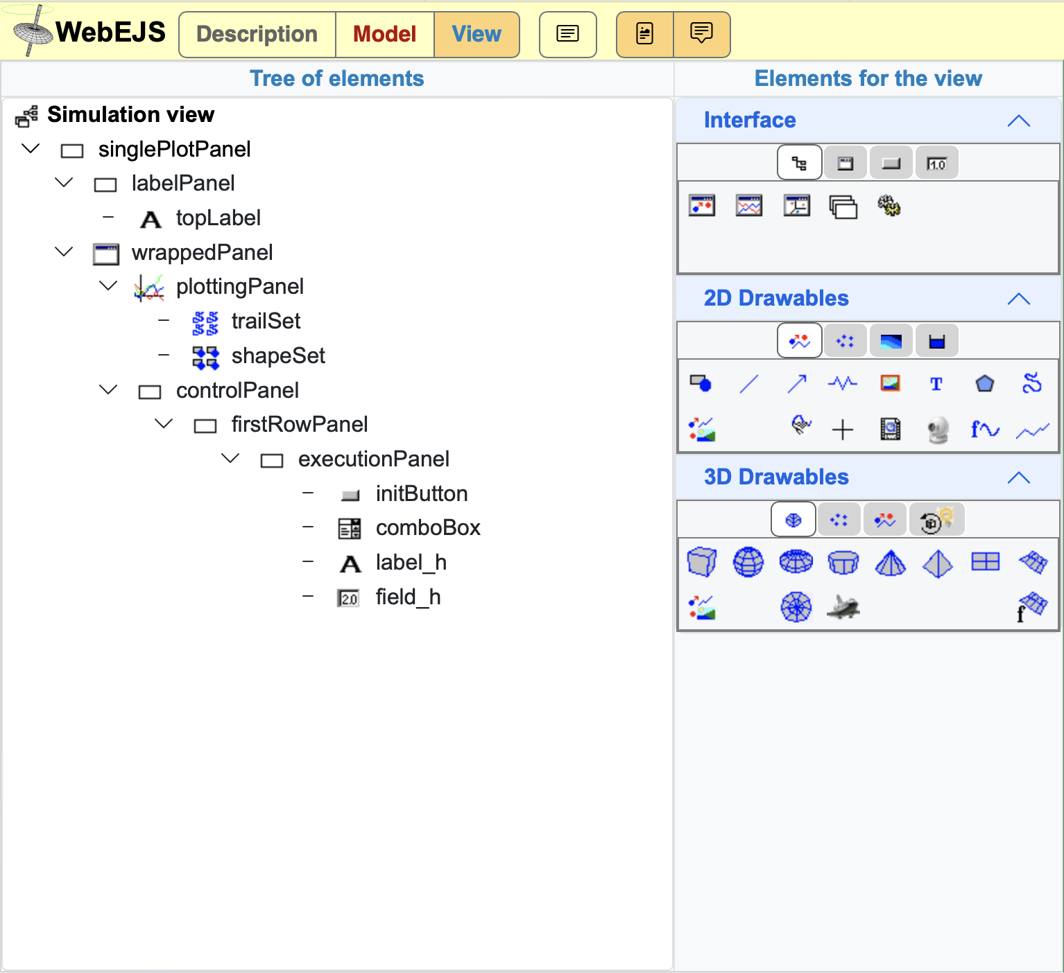
A simple interface for a simple
simulation structure
INPUT
Three work panels:
Description
Model
View
Creation of Interactive Resources Using the WebEJS Authoring Toolkit
Powered by WebEJS

Slide 5
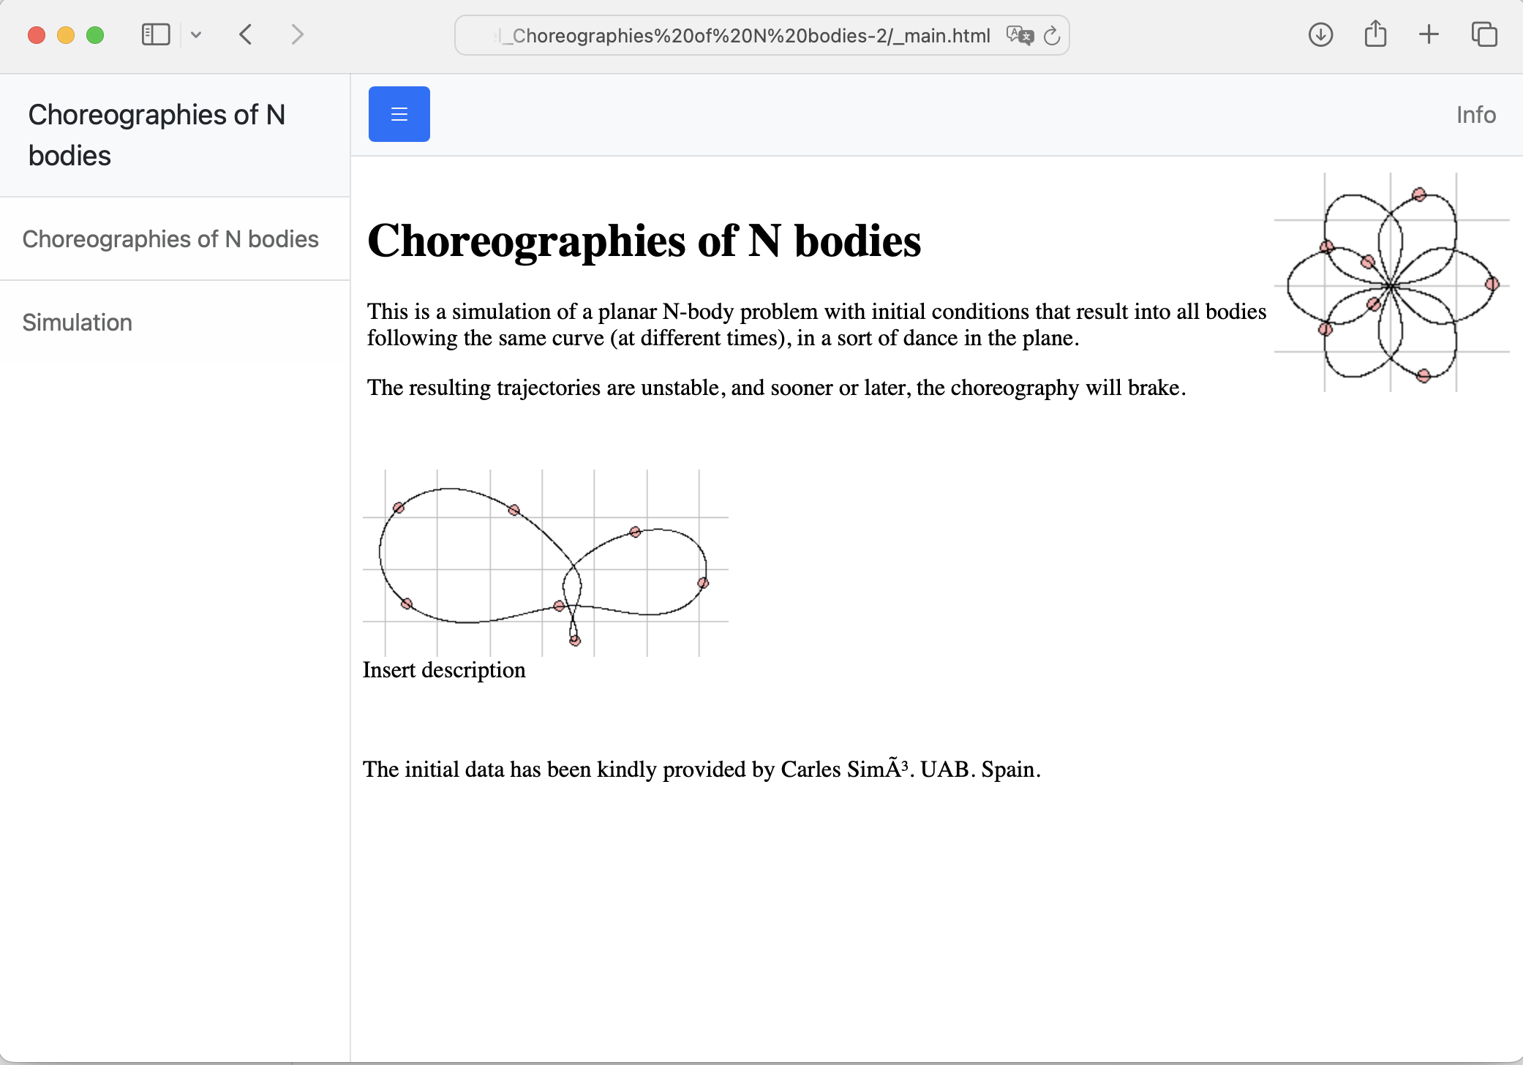
A simple interface for a simple
simulation structure
INPUT
Three work panels:
Description
Model
View
OUTPUT
One group of HTML pages:
Description pages
Simulation page
Creation of Interactive Resources Using the WebEJS Authoring Toolkit
Powered by WebEJS

Slide 6
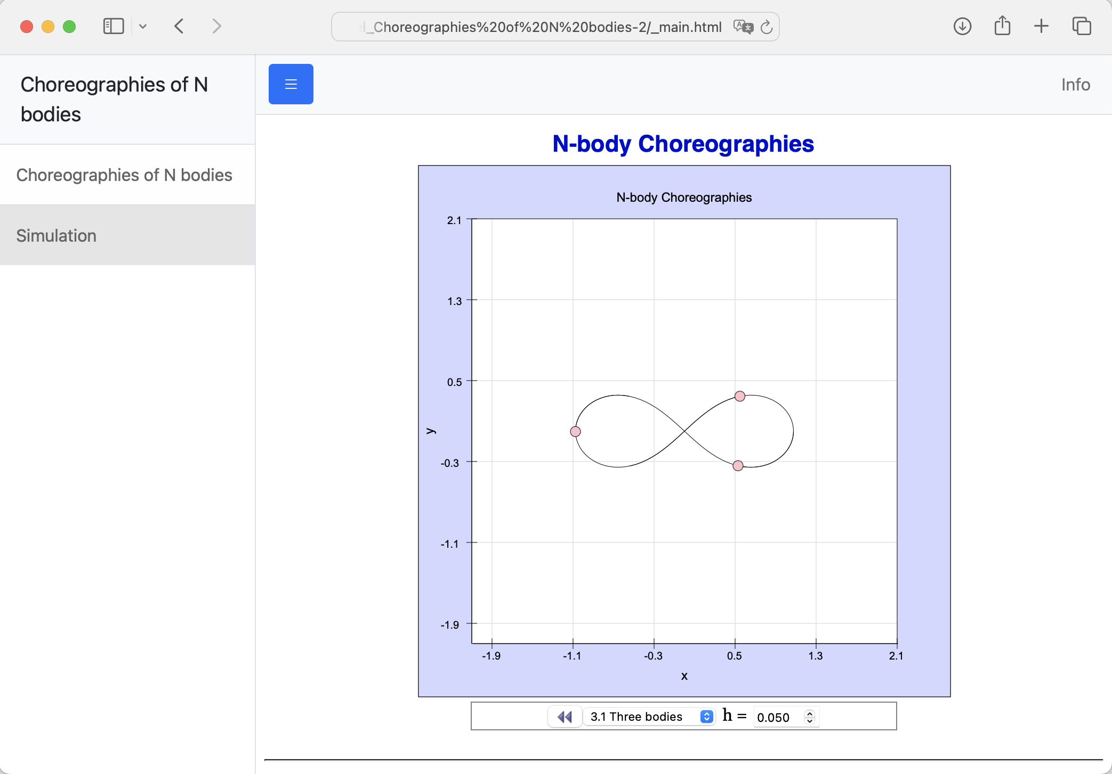
A simple interface for a simple
simulation structure
INPUT
Three work panels:
Description
Model
View
OUTPUT
One group of HTML pages:
Description pages
Simulation page
Creation of Interactive Resources Using the WebEJS Authoring Toolkit
Powered by WebEJS

Slide 7
Description pages
Description is just a work panel for creating narrative.
Show, hands-on:
- Two type of pages
Disabled pages
Internal pages
Upload files
Creation of Interactive Resources Using the WebEJS Authoring Toolkit
Powered by WebEJS

Slide 8
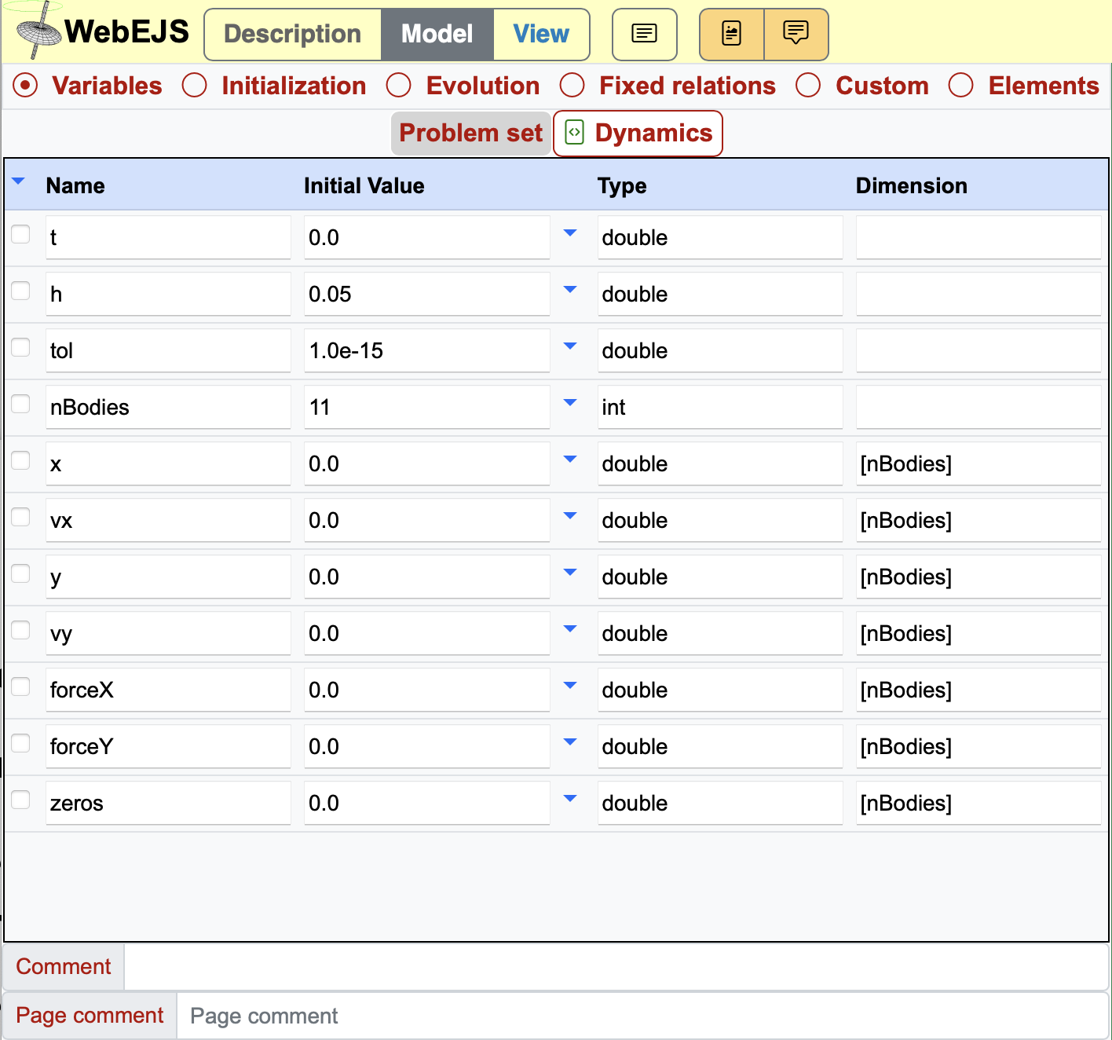
Model Tabs
Model is where we describe the logic in computer form…
…and, yes, needs training.
Show, hands-on:
- Tabs
Creation of Interactive Resources Using the WebEJS Authoring Toolkit
Powered by WebEJS

Slide 9
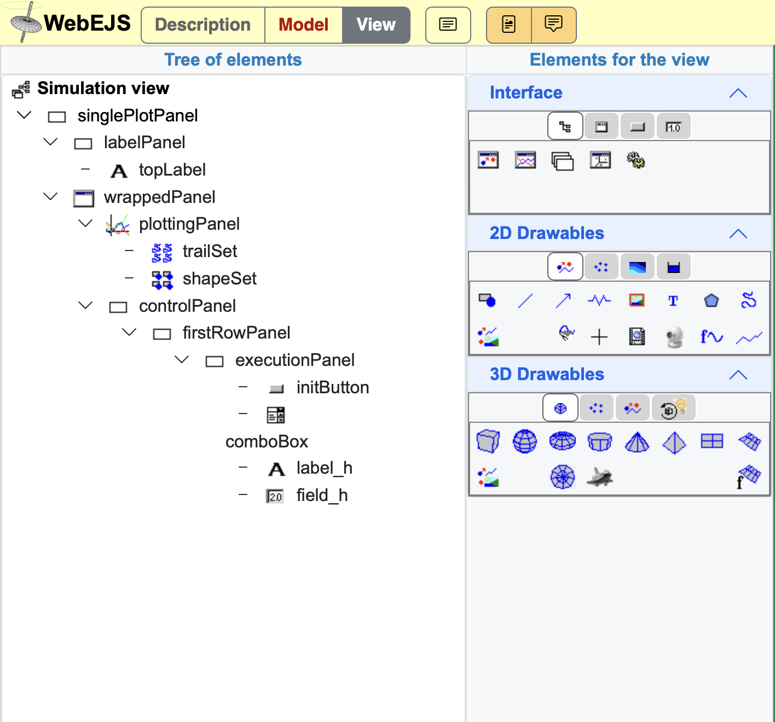
View Tree and Palette
In View we design the visualisation and user interaction…
…with predefined elements…
…that need to be learnt about.
Show, hands-on:
Drag and drop to create
Drag and drop to move
Element menu
Property editors
Binding variables to properties
Creation of Interactive Resources Using the WebEJS Authoring Toolkit
Powered by WebEJS

